Slide 1
Social Media Suicide Indication

Slide 2

Title
Team
Intro
Prob
Social Media Suicide Indication
Output
Solu

Slide 3




DS01 Group 1
Depression and Suicide Indication Detection
Abduh Salam
Dimas Samodra
Hanizar Rachman
Fahmi Fathur
Team Leader
Team Member
Team Member
Team Member
Informatika, Telkom University.
Sistem Informasi, Telkom University
Teknik Komputer, Telkom University
MBTI, Telkom University

Slide 4


Project Backgroud
According to WHO there are over 800.000 deaths cause by suicide worldwide. in US suicide is the 10th leading cause of death, estimated 1.4 Millions attempt and 48.344 americans died by suicide.
In Indonesia alone according to WHO and Pusdatin Suicide rate in Indonesia are 0.71/100.000 population or on average 1.800 cases per year. Suicide has become global issue which leads UN to set up a SDGs to reducing suicide rate 10% by 2030

Slide 5
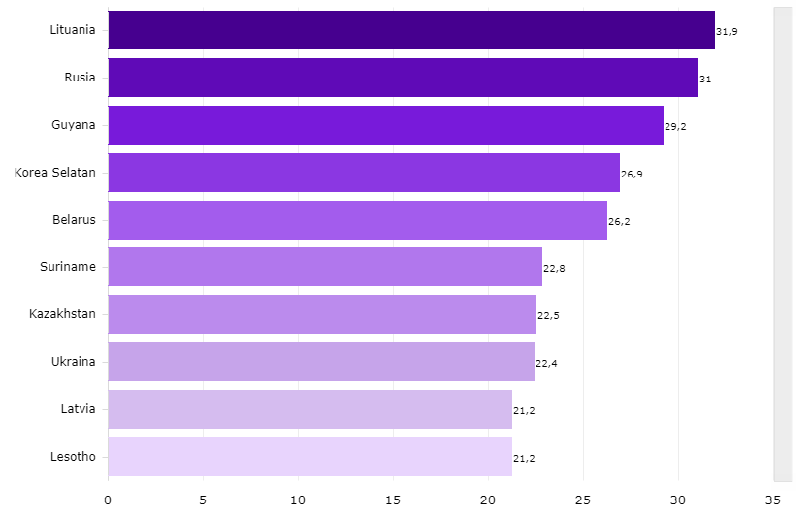

Suicide Ratio In Country
This information based on databoks.katadata.co.id showing suicide ratio every 1/100.000 people at 2018

Slide 6

Problem Based On UN Sustainable Development Goals 2030
Based on UN SDG Goals number 3 we want to sustain a Good Health and Well-Being people lives in indonesia
Our Goal
the main Goals are detecting, labeling, and preventing suicide or suicide attempts based on their social media activities. To help before its too late
How we do it
We make prediction based on Deep Learning to predict text that indicate suicide or not, so we can prevent someone was depressed to commit suicide or not by their status or post

Slide 7

Suicide detection API
API
Is an application that aims to detect a person's twitter post whether they have suicidal tendencies or not. The words from the post will be processed and classified, which will be the percentage label.
Label are used in this api is :
Normal
Suicide

Slide 8
Method used in this project
Neural Network
A neural network is a series of algorithms that endeavors to recognize underlying relationships in a set of data through a process that mimics the way the human brain operates. In this sense, neural networks refer to systems of neurons, either organic or artificial in nature.
PROS
CONS
Neural networks offer a number of advantages, including requiring less formal statistical training, ability to detect all possible interactions between predictor variables, and the availability of multiple training algorithms.
One main problem is the speed for modeling and developing the model need a lot of time
Neural Network

Slide 9
Preprocessing Workflow
Case Folding
Conver entire text in the data to standard form such as convert text to lowercase, remove number whitespace link website and many more
Tokenization
Turnacating input string based on each word that composes it
Stemming
Removing suffixes text and reduce number of variation on represention of a word
Lemmetizer
Finding the basic form of word in the data set
Text Vectorization
At last but not least convert text into numerical representation

Slide 10
Making API
Develop Model with Deep Learning
Data Scrapping
Using google collab and Python Programming Language to make Model Neural Network
Collect Data from social media and other website that related to our problem
Flask Framework
Deploy on Heroku
After model has created, then make api server with Flask
The model and API deploy on Heroku so people can access to make prediction without need configuration

Slide 11

Model Prediction
Neural Network
API using neural network layer, we used ReLU (Rectified Linear Unit) function, and Dropout Regularization to reduce overfitting.
Accuracy
With 3 Epoch, and 65 batch making Neural Network have 95.7% accuracy. With high accuracy make this model powerfull

Slide 12

API Explanation
Explanation
The Suicide Prevention API provides access to Neural Network that can predict suicidial from text. this api build from flask framework and deploy on heroku by using POST and /Posts method to communicate with api.
Requirement
Method : HTTP POST
Type : json
End Point : /Posts
Deployment : https://suicideprevention.herokuapp.com/

Slide 13

Input and Output
Request
Parameter : tweet
Type : string
Description : text that will be predicted
Required : yes
Result
Parameter : probability
Value : float
Example : 0,756584

Slide 14
How To Use API
Make file api.py, write some cod, and run it
Or open this link :
https://github.com/abduhsalam/Suicide-Prevention-DTI
Result
The result will be probability like this
{ 'probability': 0.6786270141601562 }
The result will be a number (float), if the number is getting closer to number 1, it means indicates suicide. if closer to 0 that means normal. threshold value is up to the user

Slide 15

Solutions and Future Project
Solution
Future Project
As our main goals are to detecting, labeling, and preventing. There are several point of solutions that we point it out.
Our future project are to set a bigger detection and to help others.
Offering our API to social media or organization to detect their users
More detection label
Web Dashboard contain suspect account
Prevention act based on how their mental illness
Direct Messages to Help
Collaborate with social organization or expertise in mental health issues

Slide 16
THANK YOU

